Slide 1
PYTHON
Lecture - 06
Lecture Topics
Python Functions & Modules
(Part – 01)

Slide 2
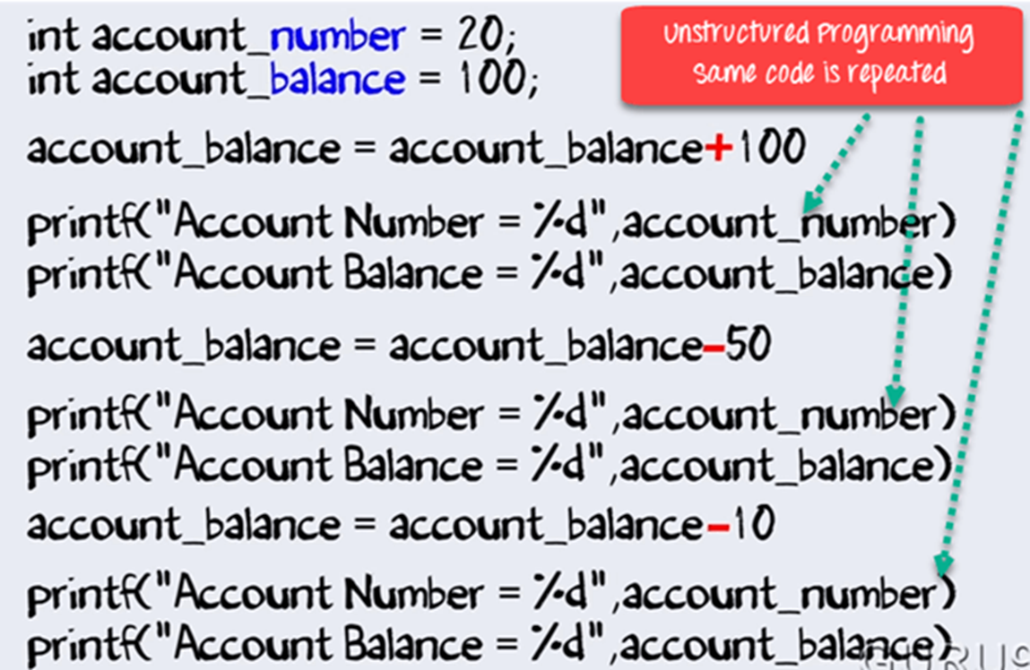
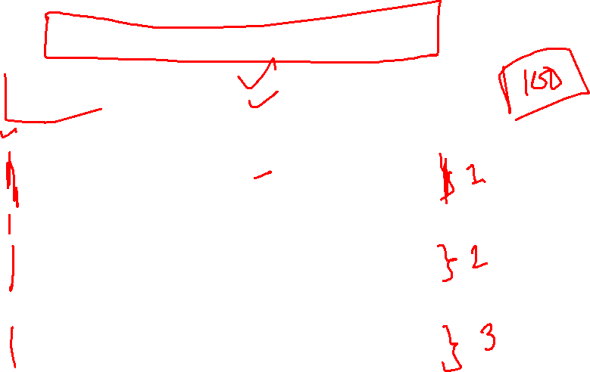
Recall: C Unstructured Code Segment

Slide 3
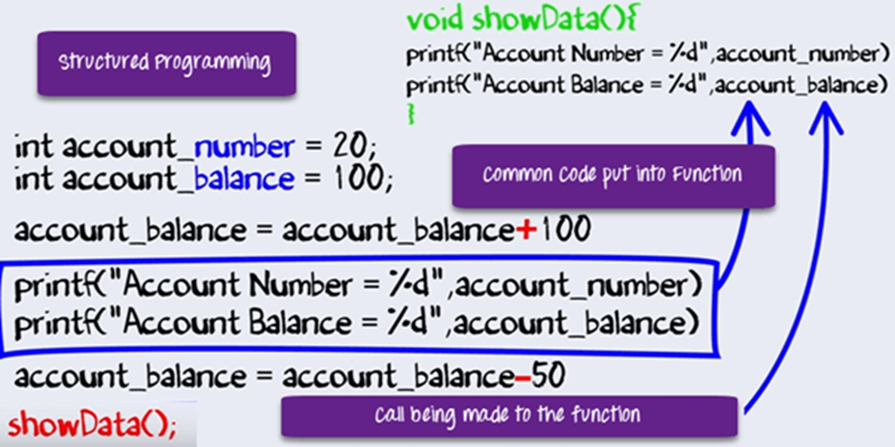
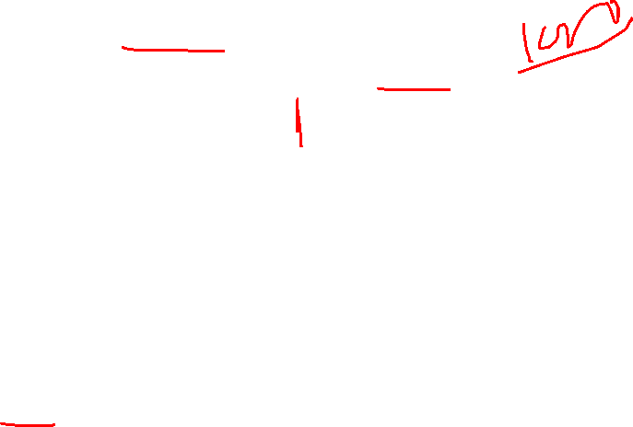
Recall: C Structured Code Segment

Slide 4
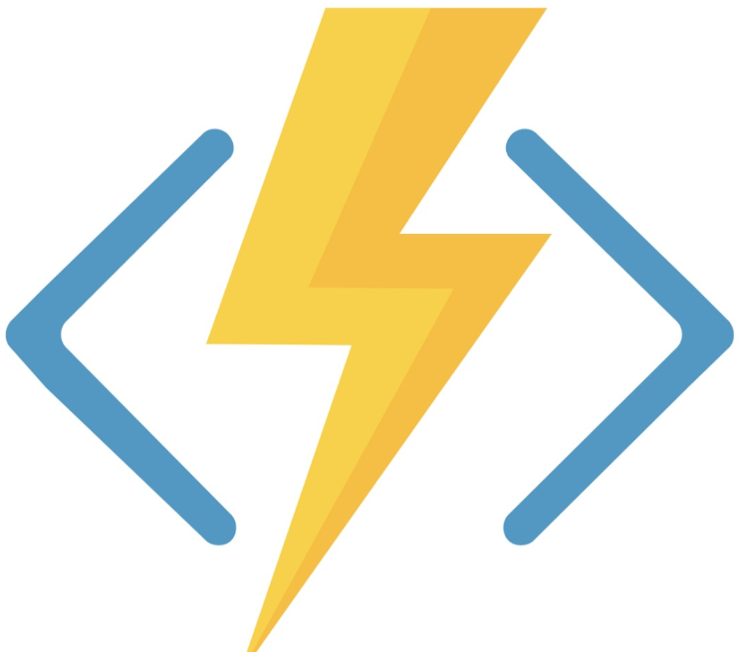

Python Functions
A function is like a mini-­program within a program.
You’re already familiar with the print(), input(), and len() functions from the previous lectures. It's called python built-in function.
For better understand how python function works, let’s create one…
def hello():
print("Hello World!")
hello()

Slide 5
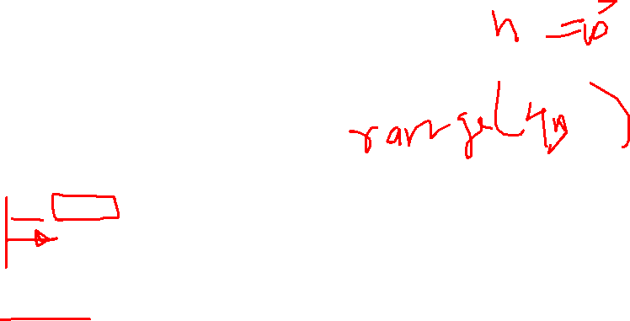
Python Functions
Keyword for defining a function
Function Name
def hello():
print("Hello World!")
hello()
Call a function
Function Details

Slide 6
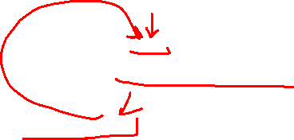
Python Functions
def Statements with Parameters:
Parameter
def hello(name):
print("Hello " + name + "!")
hello("Joy")
hello("Rini")
Argument

Slide 7
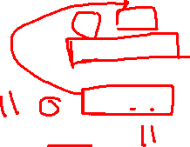
Python Functions
def Statements with return type:
def sum(a,b):
s = a+b
return s
x = sum(5,6)
print(x)

Slide 8
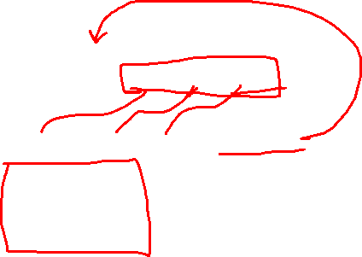
Python Functions
def Statements with multiple-return type:
def check():
return "ok",10, 3.14
str, num1, num2 = check()
print(str)
print(num1)
print(num2)
ok
10
3.14

Slide 9
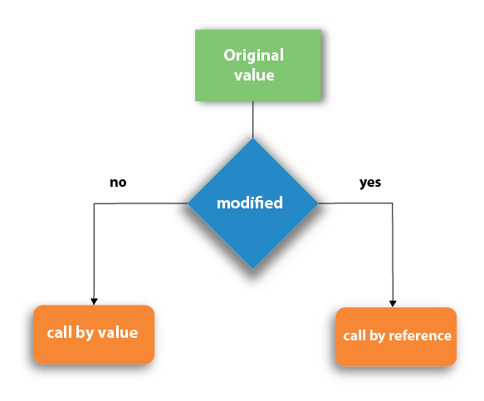
Python Functions
Call by Value vs Call by Reference
When a variable is passed to a function, if any changes to its variable does not get reflected in the actual argument, then it uses call by value mechanism. i.e. C and C++
On the other hand, if the change is reflected, then it becomes call by reference mechanism. i.e. Python

Slide 10
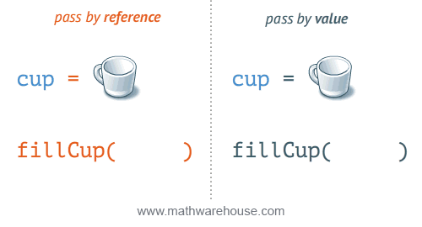
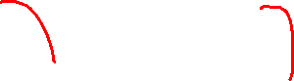
Python Functions
Call by Value vs Call by Reference

Slide 11
Python Functions
Python use call by reference technique. → How to prove?
Can use id() → it return memory location for a variable or object.
def testfunction(arg):
print ("ID inside the function:", id(arg))
var="Hello"
print ("ID before passing:", id(var))
testfunction(var)

Slide 12
Python Functions
def testfunction(arg):
print ("ID inside the function:", id(arg))
var="Hello"
print ("ID before passing:", id(var))
testfunction(var)
ID before passing: 137039164252016
ID inside the function: 137039164252016
# memory address can be vary based on device
# but it remains same before and after function call.

Slide 13
Python Functions
Python uses call by reference technique. BUT…
The behaviour also depends on whether the passed object is mutable or immutable.
→ Mutable objects can be changed after they are created. i.e. lists, dictionaries.
→ Immutable objects cannot be changed after they are created, it creates new object when it performs operation. i.e. strings, integers, or tuples.

Slide 14
Python Functions
Python uses call by reference for mutable objects.
But immutable object such as numeric object. This works as follows:
When a numeric object is passed, and then the function changes the value, it actually creates a new object in the memory, leaving the original variable unchanged.

Slide 15
Python Functions
def testfunction(arg):
print ("ID inside the function:", id(arg))
arg=arg+1
print ("new object after increment:", arg, id(arg))
var=10
print ("ID before passing:", id(var))
testfunction(var)
print ("value after function call:", var)
ID before passing: 140719550297160
ID inside the function: 140719550297160
new object after increment: 11 140719550297192
value after function call: 10

Slide 16
Python Functions
Python uses call by reference technique. AND…
Python List object is also mutable.
It is also passed by reference, as the id() of list before and after passing is same. However, if we modify the list inside the function, its global representation also reflects the change.

Slide 17
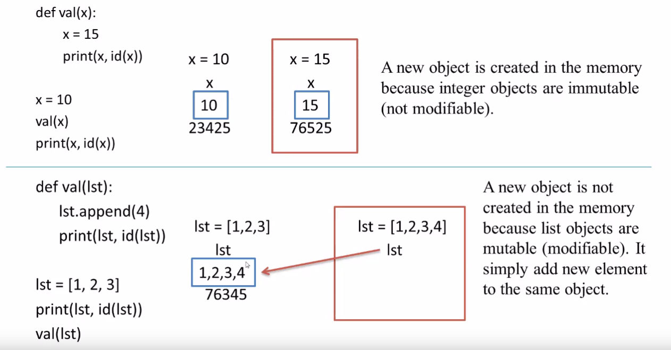
Python Functions
76345

Slide 18
Python Functions
def testfunction(arg):
print ("Inside function:",arg)
print ("ID inside the function:", id(arg))
arg=arg.append(100)
var=[10, 20, 30, 40]
print ("ID before passing:", id(var))
testfunction(var)
print ("list after function call:", var)
ID before passing: 132562306735872
Inside function: [10, 20, 30, 40]
ID inside the function: 132562306735872
list after function call: [10, 20, 30, 40, 100]

Slide 19
Python Functions
Positional or Required Arguments
What is the output of the code???
def printme( str ):
print (str)
return
printme()
As we pass
parameter here
WHY
??
We must pass a argument here
Traceback (most recent call last):
File "/home/ribnat/Python.py", line 5, in <module>
printme()
TypeError: printme() missing 1 required positional argument: 'str'

Slide 20
Python Functions
Keyword Arguments
We can pass arguments in different order.
def printinfo( name, age ):
print ("Name: ", name)
print ("Age: ", age)
return
printinfo( age=50, name="miki" )
Name: miki
Age: 50

Slide 21
Python Functions
Default Arguments
A default argument is an argument that assumes a default value if a value is not provided in the function call for that argument.
def printinfo( name, age = 35 ):
print ("Name: ", name)
print ("Age: ", age)
return
printinfo( name="miki" )
As we don’t pass age arg, it takes 35 as default.
Name: miki
Age: 35

Slide 22
Python Functions
Default Arguments
A default argument is an argument that assumes a default value if a value is not provided in the function call for that argument.
def printinfo( name, age = 35 ):
print ("Name: ", name)
print ("Age: ", age)
return
printinfo( "miki", 50 )
Name: miki
Age: 50

Slide 23
Python Functions
Built-in Mathematical Functions
abs() | Returns the absolute value of x, i.e. the positive distance between x and zero. | X = abs(-5) → 5
max() | Returns the largest of its arguments or largest number from the iterable (list or tuple). | max(5,9) →9
min() | Returns the smallest of its arguments or smallest number from the iterable (list or tuple) | min(5,9) →5
pow() | Returns x raised to y. It is equivalent to x**y. The function has third optional argument mod. If given, it returns (x**y) % mod value. | pow(2,3) →8
round() | Returns x rounded to n digits from the decimal point. | round(5.8) →6
sum() | Returns the sum of all numeric items in any iterable (list or tuple). An optional start argument is 0 by default. If given, the numbers in the list are added to start value. | sum(5,6) →11

Slide 24
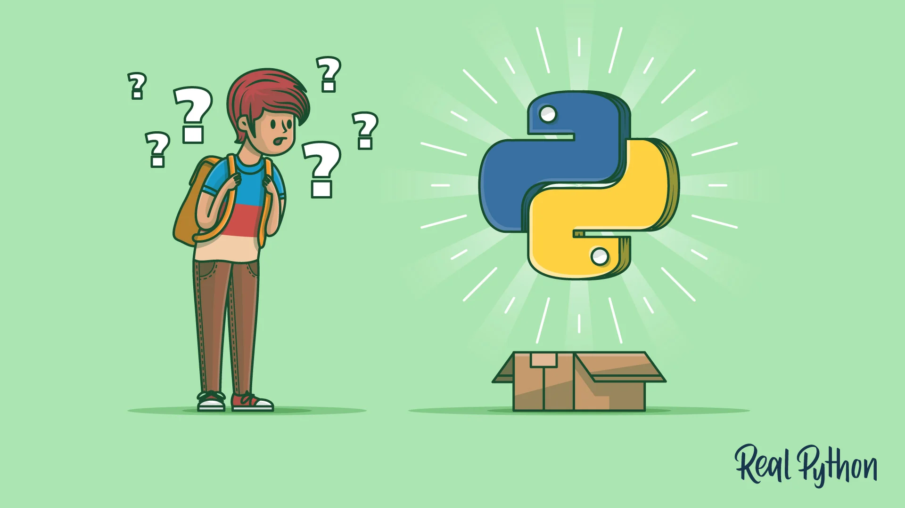
Exercise Time

Slide 25
Exercise – 6.1 (Using Function)
Print all even numbers from 1 to N.
Print all numbers from 1 to N except those, that are divisible by 5.
Print all numbers from 1 to N that are divisible by 3 or 4 but not 5.
Print all prime numbers from 1 to N.

Slide 26
Exercise – 6.2
Write a Python program that computes the greatest common divisor (GCD) of two positive integers.
Input:
8
12
Output:
4

Slide 27
Exercise – 6.2 (ans)
x = 86
y = 44
n = min(x,y)
gcd = 0
for i in range(1,n+1):
if x%i == 0 and y%i == 0:
gcd = i
print(f"The GCD of {x} and {y} is {gcd}.")
# It’s called formatted string, which helped to print
# variables with strings.

Slide 28
Exercise – 6.3
Write a Python program to find the least common multiple (LCM) of two positive integers.
Input:
8
12
Output:
24

Slide 29
Exercise – 6.3 (ans)
num1 = 8
num2 = 12
for i in range(max(num1, num2), 1 + (num1 * num2), max(num1, num2)):
if i % num1 == i % num2 == 0:
lcm = i
break
print("LCM of", num1, "and", num2, "is", lcm)

Slide 30
Exercise – 6.4
Take a List as input and find its MEX.
MEX is smallest non-negative number that isn’t present in the list.
Input_1: [2, 1, 4, 0, 5]
Output_1: 3
Input_2: [2, 1, 4, 0, 5, 3]
Output_2: 6
Hints: you can sort the List using the function sort(), then find out the mex using a loop, but how? Think yourself.
A = [5, 2, 4]
A.sort()
print(A) → [2, 4, 5]

Slide 31
Exercise – 6.4 (ans)
arr = [2, 1, 4, 0, 5, 1]
N = len(arr)
arr.sort()
mex = 0
for idx in range(N):
if arr[idx] == mex:
mex += 1
print(mex)

Slide 32
Exercise – 6.5
You are given a phone number as a string. Report as “INV” if the number is invalid. Otherwise find out its operator company name. Every valid number has exact 11 digits and first 3 digits decide it’s operator company name. Here is the list of valid operators & their codes:
Grameenphone → ‘017’ or ‘013’
Teletalk → ‘015’
Banglalink →’014’ or ‘019’
Airtel →’016’
Robi →’018’
Sample Input: "01411111111"
Sample Output: “Banglalink”
Solve the Problem using match case

Slide 33
Exercise – 6.5 (ans)
num = input()
if(len(num)!=11):
print("INV")
match num[:3]:
case "017":
print("Grameenphone")
case "013":
print("Grameenphone")
case "014":
print("Banglalink")
case "019":
print("Banglalink")
case "015":
print("Teletalk")
case "016":
print("Airtel")
case "018":
print("Robi")
case _:
print("INV")

Slide 34
Resources
https://www.tutorialspoint.com/python/index.htm
https://www.w3resource.com/python/python-tutorial.php
https://www.w3resource.com/python-exercises/string/
https://www.w3schools.com/python/
https://www.geeksforgeeks.org/python-programming-language/
https://youtu.be/t2_Q2BRzeEE?si=OO6J_YNCZykedqsT
https://realpython.com/
Head First Python, 3rd Edition by Paul Barry
Automate the Boring Stuff with Python By Al Sweigart.

Slide 35

Thank You

